Slide 1
Exploring Register File Size and Memory Organization in ASIP Synthesis
Manoj Kumar Jain
Department of Computer Science & Engineering
IIT Delhi
http://www.cse.iitd.ernet.in/esproject
Thesis presentation, 24th May, 2004

Slide 2
Outline
Introduction and Objectives
Motivating Study
Storage Exploration Methodology
Estimating Execution Time with Limited Regs.
Overheads due to Limited Register Windows and Cache Misses
Design Space Exploration Results and Validation
Application of the Proposed Approach
Major Research Contributions
Future Research Directions
Publications

Slide 3
Application Specific Instruction Set Processors (ASIPs)
Designed for specific application or a set of applications
Exploits special characteristics to meet the desired constraints
Efficient for applications like digital signal processing, cellular phones etc.

Slide 4
Different Processor Technologies
ASIC
ASIP
Performance
(also HW design efforts)
GPP
Flexibility
(also design reuse, power consumption)

Slide 5
ASIP Design Space
Operations which can be done in parallel or
Chained, can be grouped into a new instruction
Reduces instruction size, time and power
Instruction set
Data path
Memory
Interconnect
Word length adaption
Number of Fus
Application Specific Fus
Register File Size/ Structure
Number and Sizes of banks
Number and sizes of access ports
Cache organization (Size, block size, levels, policies)
Special memories: Scratchpad, FIFO
Reduced functionality compared to standard bus
Add special path to improve performance

Slide 6
Flow Diagram of ASIP Design Methodology
Application &
Design Constraints
[VLSI Design 2001]
Application Analysis
Architectural Design Space Exploration
Instruction Set
Generation
Code Synthesis
Hardware Synthesis
Object Code
Processor Description

Slide 7
Approaches in ASIP Design Space Exploration
Efficient retargetable compiler and simulator required
Slower
More accurate
More architectural features have been explored
Application
(C)
Retargetable
Compiler
Object
Code
Retargetable
Simulator
Simulator based
Architecture
Description
Trace Data
No target specific code generation
Faster
Less accurate
Less architectural features have been explored
Application
(C)
Retargetable
Estimator
Profiler
Scheduler based
Architecture
Description
Performance and
other Estimates

Slide 8
Overall Objectives
Fast design space exploration to explore increasing design space
Storage organization to be explored by scheduler based approach
Exploring register file size, register windows and cache configuration

Slide 9
Register Size Evaluation: Motivating Study
Study the impact of changing the number of
registers on
Performance (# cycles), Power, Energy and Code size
Experimental Framework
Wehmeyer/ Jain TCAD 2001
C Code
encc
assembly
Assembler &
Linker
executable
energy
database
profiling
information
trace
analyzer
trace file
ISS

Slide 10
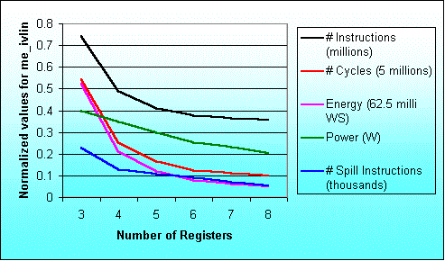
Result for the program me_ivlin

Slide 11
Storage Exploration Methodology: ASSIST
Overall Execution Time = Execution Time with Constrained Register File
+ Overhead due to limited Register Windows
+ Overhead due to Cache Misses
ET = et_{R} + oh_{W} + oh_{C}
[Euro DSD 2003]
Compute #window
Spills and Restores
Application + Per. Constraints
Cache simulator
Parameterized
Processor
Register allocation using RRCs
Scheduling
Parameterized
Memory
Execution time estimate
et_{R}
Overhead due to
window spills
oh_{W}
Overall Execution time est.
oh_{C}
Overhead due to
cache misses
ET
Storage configuration selector

Slide 12
Exec. Time Estimates with Limited Registers: Methodology
[CASES 2002]
Application
Profiling
Processor description
[Accepted for TCAD]
SUIF
Profile information
SUIF IR
Dependence analysis
Control flow graph
Data flow graph
Local register allocation
using reuse chains
Estimate overhead to
handle global needs
For each Basic Block
Modified data flow graph
Local execution time estimate
Schedule overhead
due to global needs
Scheduling
For each function
Schedule estimate of single
execution of the basic block
Execution time estimates

Slide 13
Register Allocation using Register Reuse Chains
Traditional compilers : One pass of scheduling before RA
Register optimization is very important in ASIP design
Register need estimation on unscheduled code is done
A Register Reuse Chain or RRC [Zhang 99] contains
all the variables assigned to the same register
Generating Initial Chains
Converting Initial Chains into dependence conservative chains
Computing merging costs
Efficiently merging chains

Slide 14
Illustrative Example
l_2
a
load a;
b=2*a;
c=a+3;
d=a-4;
e=c*d;
f=c-d;
g=e/f;
h=g+5;
i=h*6;
j=h+7;
k=i/j;
l=b+k;
Source Code
l_3
l_4
b
c
d
e
f
g
l_5
h
l_6
l_7
i
j
k
Dependency Graph
l_x constant x loaded into reg
l

Slide 15
Generating Initial Reuse Chains
Earliest Ultimate Killing (EUK) Node is the earliest node where Variable’s live range is guaranteed to end
Earliest Ultimate Killing or EUK nodes are used to construct RRCs
Basic Idea Recursively search the EUK nodes and assign the same register.

Slide 16
Reuse Chains Formation:
Initial Chains
l_2
a
Initial Chains
Chain 0 < a, l >
Chain 1 < l_2, b >
Chain 2 < l_3, c, g, h, k >
Chain 3 < l_4, d, i >
Chain 4 < l_5, j >
Chain 5 < l_6 >
Chain 6 < l_7 >
Chain 7 < e >
Chain 8 < f >
Variable EUK
a l
l_2 b
b l
l_3 c
c g
l_4 d
d g
e g
f g
g h
l_5 h
h k
l_6 i
i k
l_7 j
j k
k l
l l
l_3
l_4
b
c
d
e
f
g
l_5
h
l_6
l_7
Dependency Graph
i
j
k
l

Slide 17
Reuse Chains Formation: Dependence conservative chains
l_2
a
Initial Chains
Chain 0 < a, l >
Chain 1 < l_2, b >
Chain 2 < l_3, c, g, h, k >
Chain 3 < l_4, d, i >
Chain 4 < l_5, j >
Chain 5 < l_6 >
Chain 6 < l_7 >
Chain 7 < e >
Chain 8 < f >
Variable EUK
a l
l_2 b
b l
l_3 c
c g
l_4 d
d g
e g
f g
g h
l_5 h
h k
l_6 i
i k
l_7 j
j k
k l
l l
l_3
l_4
b
c
d
e
f
g
Dependence conservative chains
Chain 0 < a >
Chain 1 < l_2, b, l >
Chain 2 < l_3, c, e, g, h, i, k >
Chain 3 < l_4, d >
Chain 4 < l_5 >
Chain 5 < l_6 >
Chain 6 < l_7, j >
Chain 7
Chain 8 < f >
l_5
h
l_6
l_7
Dependency Graph
i
j
k
l

Slide 18
Computing Merging Costs
Ch 5
Ch 6
l_7
l_6
j
Ch 6
store
store
l_7
Ch 5
j
l_6
M _{5,6} = 2
load
M _{6,5} = 3
load
i
i
load
k

Slide 19
Local Execution Cycles Estimates with diff. Register File Sizes
k | Register Reuse Chains | LE _{B,k}
>7 | <a>, <l_2,b,l>, <l_3,c,e,g,h,i,k>, <l_4,d>, <l_5>, <l_6>, <l_7,j>, <f> | 29
7 | <a>, <l_2,b,l>, <l_3,c,e,g,h,i,k>, <l_4,d,l_5,l_6>, <l_7,j>, <f> | 35
6 | <a>, <l_3,c,e,g,h,i,k>, <l_4,d,l_5,l_6,l_2,b,l>, <l_7,j>, <f> | 38
5 | <a>, <l_3,c,e,g,h,i,k>, <l_4,d,l_5,l_6,l_7,j,l_2,b,l>, <f> | 43
4 | <a,l_4,d,l_5,l_6,l_7,j,l_2,b,l>, <l_3,c,e,g,h,i,k>, <f> | 50
3 | <a,l_4,d,f,l_5,l_6,l_7,j,l_2,b,l>, <l_3,c,e,g,h,i,k> | 55

Slide 20
Allocation of Registers for Local and Global Needs
Optimal distribution of total available registers
  Registers for local allocation
  Registers to handle global needs
Suitable decision is made for each basic block

Slide 21
Snap shot from adpcm encoder
{valpred}
{delta, sign, index}
{bufferstep, outp, outputbuffer}
{valpred}
{valpred}
{valpred}
{delta, index}
{sign}
{index}
{delta}
[bufferstep, outp, outputbuffer]
{index}

Slide 22
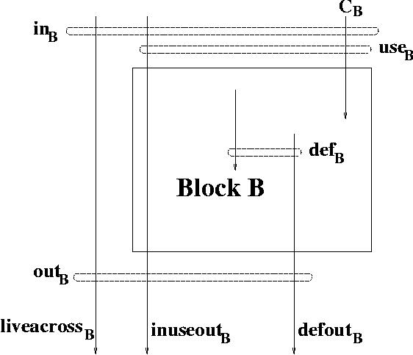
Variable Use Sets Analysis
Total register needs ||liveacross _{B} ^{R}|| + max(||defout _{B}|| + ||inuseout _{B}||, k)
||S|| Cardianility of set S
S ^{R} Subset of S which gets registers

Slide 23
Overheads due to Limited Register Windows
function calls and returns sequence is generated using application instrumentation [Vishal 2002]
Stack based analysis performed to know window spills
Overhead computation
  Register file configuration (#windows, win. size)
  Processor configurartion

Slide 24
Overheads due to Cache Misses
Observation : Usually the number of memory locations required to store scalar variables and register winodws is small compared to total number of cache locations
Sim-cache from simplescalar tool set used to find memory access profiles
Overhead is computed as
d = α1 + α2 * (b - 1)
α1 : time for first data transfer from memory to cache
α2 : time for each remaining data transfer
b : block size

Slide 25
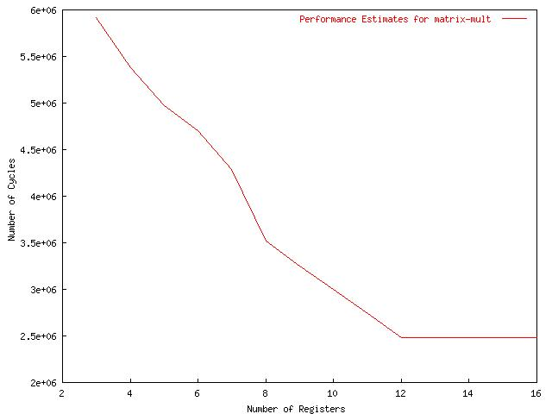
Excution time for matrix-mult with diff. Register file sizes for ARM7TDMI

Slide 26
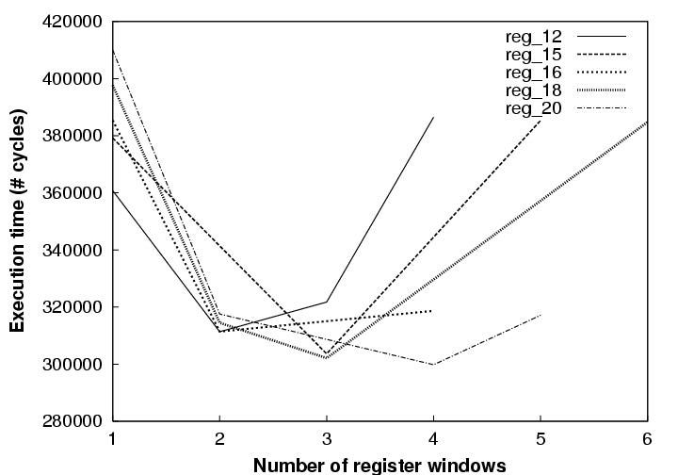
Trade off Number of Register Winodws and Window Size for quick sort on LEON

Slide 27
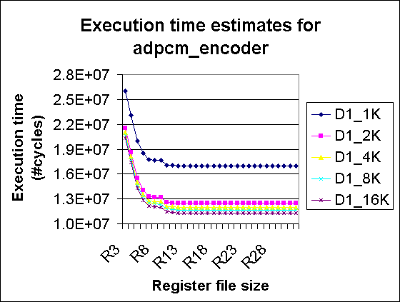
Exploring Reg. File and Cache Size

Slide 28
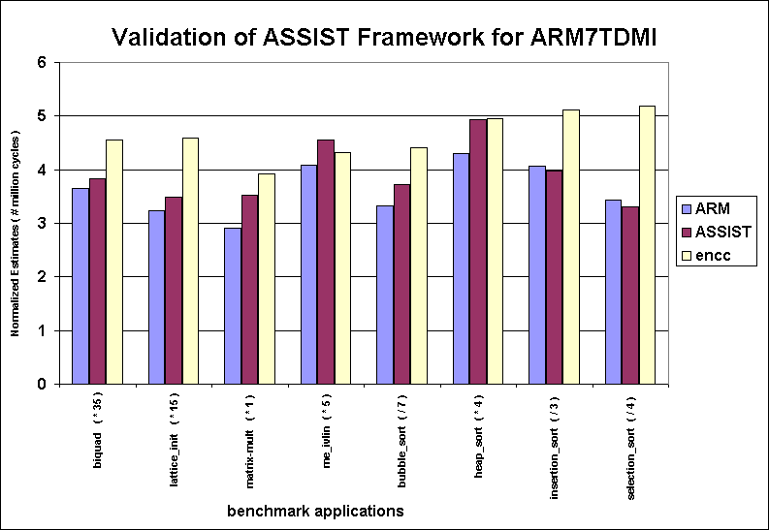
Validation of ASSIST for ARM7TDMI

Slide 29
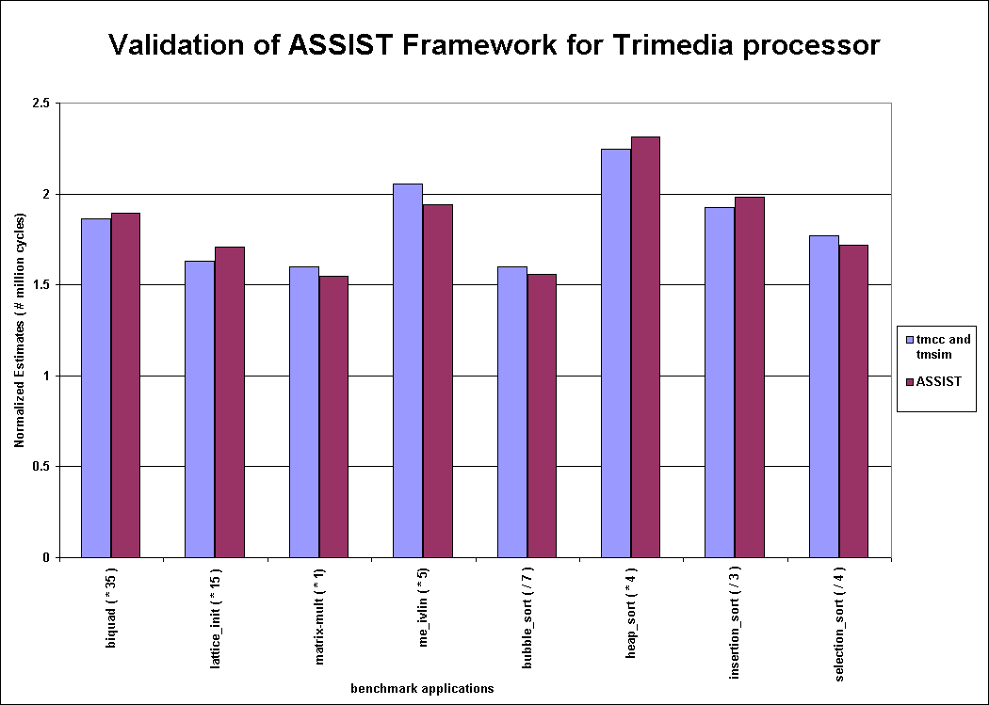
Validation of ASSIST for TM-1000

Slide 30
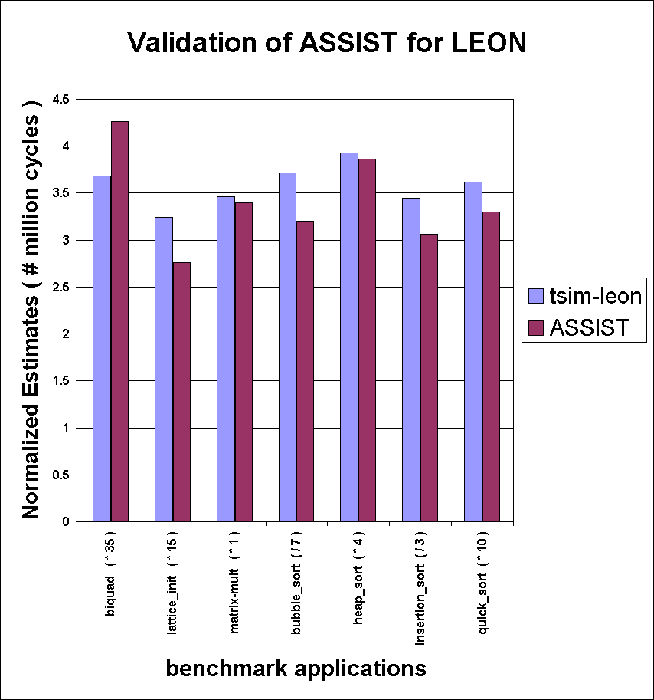
Validation of ASSIST for LEON

Slide 31
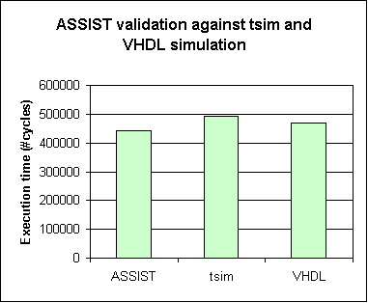
Validation of ASSIST for collision detection application on LEON

Slide 32
Application of Proposed Approach
Suitable register file may reduce address bits
  Reduction in instruction width
  Saving in power
  Room of application specific instruction
Other usage of ‘extra’ registers/ reg. addresses
  Simplifying coproc interface
  Use as control/ status register

Slide 33
Simplifying LEON coproc interface
Memory
IU
FPU
Standard Interface

Slide 34
Simplifying LEON coproc interface contd.
Register file
IU
FPU
Proposed Interface

Slide 35
How it is done normally ?
IU reg add
decoder
IU regs.
IU Register File
Reg. Address
(IU)
coproc reg add
decoder
Reg. Address
(Coproc)
Coproc Register File
FPU regs.

Slide 36
How we do it ?
IU reg add
decoder
IU regs.
IU Register File
Reg. Address
(IU)
coproc reg add
decoder
Reg. Address
(Coproc)
Coproc Register File
FPU regs.

Slide 37
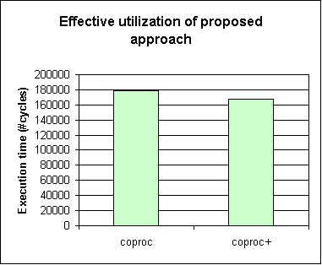
Case study : Collision Detection

Slide 38
Major Research Contributions
Storage exploration methodology for ASIPs
  Scheduler based
  Retargetable
Technique validated for a number of processors with different features against the cycle count numbers produced by their standard tool sets
Demonstrated application of the proposed approach

Slide 39
Future directions
Issues not addressed by the proposed approach
  Impact of register file size on instruction width
  Change in clock cycle due to processor reconfiguration
  Such technique for power/ energy estimation

Slide 40
Publications
L. Wehmeyer, M.K. Jain, S. Steinke, P. Marwedel and M. Balakrishnan:
“Analysis of the Influence of the Register File Size on Energy Consumption,
Code Size and Execution Time”, IEEE TCAD, vol. 20, no. 11, Nov. 2001.
M.K. Jain, M. Balakrishnan and Anshul Kumar: “An Efficient Technique for
Exploring Register File Size in ASIP Design” accepted, IEEE TCAD.
M.K. Jain, M. Balakrishnan and Anshul Kumar: “ASIP Design
Methodologies: Survey and Issues”, VLSI Design 2001.
M.K. Jain, L. Wehmeyer, S. Steinke, P. Marwedel and M. Balakrishnan:
“Evaluating Register File Size in ASIP Synthesis”, Ninth International
Symposium on Hardware/ Software Codesign, CODES 2001.

Slide 41
Publications contd.
L. Wehmeyer, M.K. Jain, S. Steinke, P. Marwedel and M. Balakrishnan:
“Using a retargetable, Energy aware Compiler Framework for Deciding
Number of Registers in ASIP Design”, Fifth International Workshop on
Software and Compilers for Embedded Systems, SCOPES 2001.
M.K. Jain, M. Balakrishnan and Anshul Kumar: “An Efficient Technique
for Exploring Register File Size in ASIP Synthesis”, Fifth International
Conference on Compilers, Architectures and Synthesis for Embedded
Systems, CASES 2002.
M.K. Jain, M. Balakrishnan and Anhul Kumar: “Exploring Storage
Organization in ASIP Synthesis”, Euromicro Symposium on Digital
Systems Design, Euro-DSD 2003.

Slide 42
Publications contd.
M.K. Jain: “ASIP Design Methodologies : Survey and Issues”,
TR #2000/24, Embedded Systems Project, Department of
Computer Science and Engineering, IIT Delhi.
M.K. Jain, L. Wehmeyer, P. Marwedel and M. Balakrishnan:
“Register File Synthesis in ASIP Design”, TR #2000/746,
Department of CS XII, University of Dortmund, Germany.

Slide 43
Acknowledgements
Prof. M. Balakrishnan and Prof. Anshul Kumar
DST and NRB for sponsorship
Other research scholars in the department

Slide 44
Thanks

Slide 45
GPP-ASIP-ASIC
ASIPs (Application Specific Instruction Set Processors)
Designed for specific application
Exploits special characteristics to meet the desired constraints
Efficient for applications like digital signal processing, automatic control systems, cellular phones etc.
 | GPP | ASIP | ASIC
Performance | Low | High | Very High
Flexibility | Excellent | Good | Poor
HW Design Effort | Nil | Large | Very Large
SW Design Effort | Small | Large | Nil
Power | Large | Medium | Small
Reuse | Excellent | Good | Poor
Markets | Very Large | Relatively large | Small
Cost | Mainly on SW | S-O-C | Volume sensitive

Slide 46
Requirements of ASIP Design
Start with the application behavior
Evaluate and choose from available architectural options
Identify HW functionalities to speed up the application
  Special hardware for frequently used operations
  Remove redundant hardware

Slide 47
Specific Examples
Multiplier accumulator unit
Floating point arithmetic unit
No.of ALUs in VLIW
Presence or absence of Cache

Slide 48
Previous work on Storage Exploration
Register banks , I/D-Cache [Gloria90, Gong95, Kin99]
Attempt to optimize register count based on profiler information but method needs code generation and analysis [Honma94]
Language based approach [Mishra2001]

Slide 49
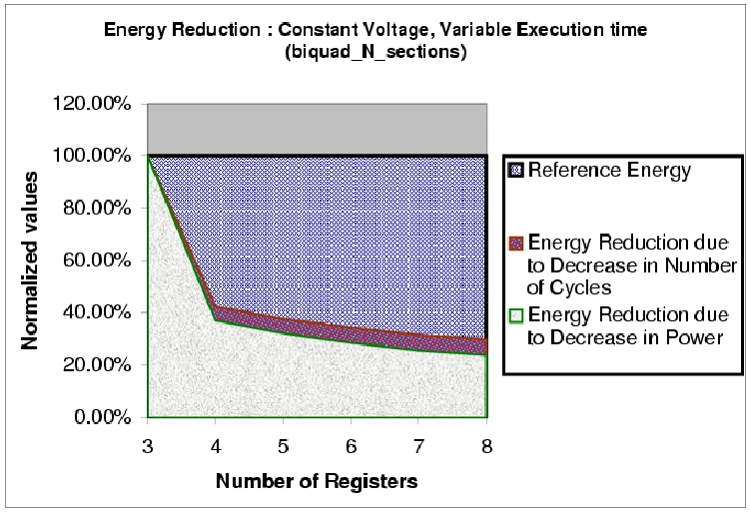
Notes:
Supply voltage is 3.3 V for all observations. Clock period is 30.52 NS
Contribution of time saving and power saving in reducing energy are shown.
The blue shaded area shows energy reduction due to time saving.
The brown shaded area shows energy reduction due to power saving.

Slide 50
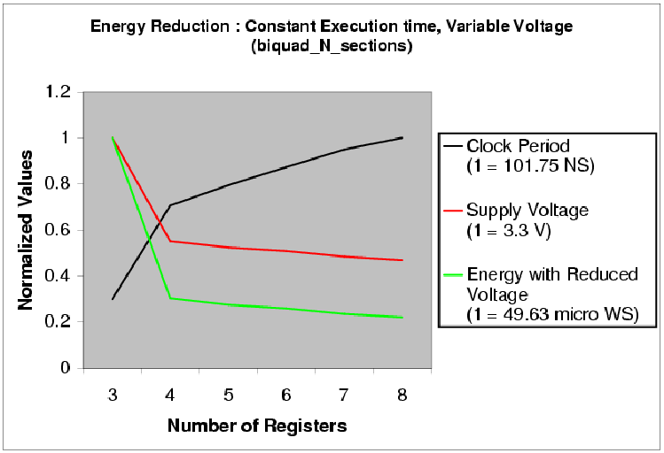
Notes:
Here we have assumed total execution time as constant.
To keep execution time as constant when execution requires lesser number
of cycles we have increased the clock period.
With the increased clock period we can reduce supply voltage.
For estimating supply voltage with varying clock period we had referred
The paper titled “Low Power CMOS Digital Design” – A.P Chandrakasan et al
IEEE J. Solid-State Circuits, Vol. 27, No. 4, pp. 473-484, April 1992.
With this estimated voltage we have calculated Energy.
Since Energy is product of Average Power Consumption and Execution time,
here Execution time is constant and
Power depends quadratically on Voltage.
Keeping these facts into consideration we have computed
Energy Consumption.

Slide 51
Maximum variation in results
Benchmark Program | Performance |  | Power |  | Energy
 | Reg. size | % inc. | Reg. size | % red. | Reg. size | % red.
biquad_N_sections | 3 → 4 | 57.5 | 3 → 4 | 12.6 | 3 → 4 | 62.9
lattice_init | 4 → 5 | 20.5 | 6 → 7 | 1.0 | 4 → 5 | 21.0
matrix-mult | 3 → 4 | 29.7 | 7 → 8 | 7.4 | 3 → 4 | 33.4
me_ivlin | 3 → 4 | 53.4 | 5 → 6 | 15.3 | 3 → 4 | 59.3
bubble_sort | 4 → 5 | 46.3 | 4 → 5 | 17.3 | 4 → 5 | 55.6
heap_sort | 6 → 7 | 25.6 | 6 → 7 | 10.3 | 6 → 7 | 33.2
insertion_sort | 4 → 5 | 44.8 | 4 → 5 | 22.3 | 4 → 5 | 57.1
election_sort | 3 → 4 | 22.2 | 5 → 6 | 14.0 | 5 → 6 | 30.1
Average |  | 37.5 |  | 12.5 |  | 44.1

Slide 52
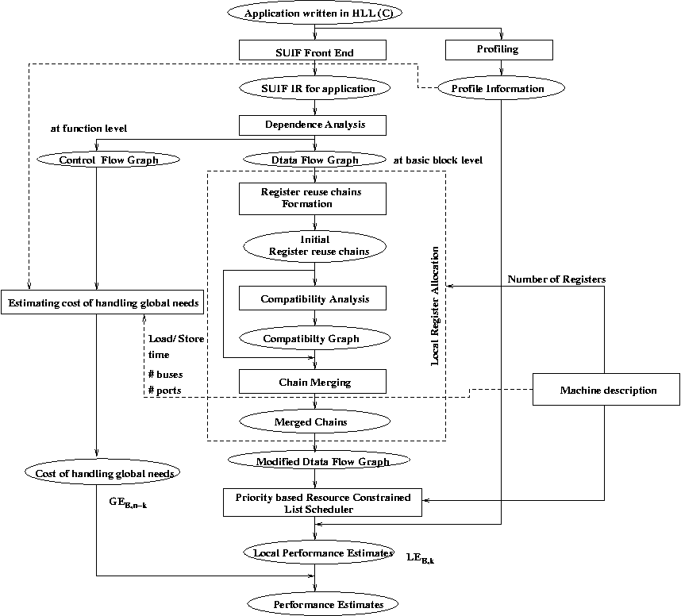

Slide 53
Methodology contd.
ET = et_{R} + oh_{W} + oh_{C}
Where
ET : Total application execution time
et_{R} : Execution time when reg. file contains R regs.
oh_{W} : Additional overhead due to window spills
oh_{C} : Additional overhead due to cache misses
et_{R} = bet + oh_{dep} + spill_{R} * t_{R}
bet : Base execution time (without storage constraints)
oh_{dep} : Overhead due to additional dependencies
spill_{R} : Number of register spills
t_{R} : Delay associated with each register spill
oh_{W} : spill_{W} * t_{W}
spill_{W} is number of window spills t_{W} is delay /window spill
oh_{C} = miss_{C} * t_{C}
miss_{C} is number of cache misses t_{C} is cache miss penalty

Slide 54
Computing Merging Costs
l_2
a
Dependence conservative chains
Chain 0 < a >
Chain 1 < l_2, b, l >
Chain 2 < l_3, c, e, g, h, i, k >
Chain 3 < l_4, d >
Chain 4 < l_5 >
Chain 5 < l_6 >
Chain 6 < l_7, j >
Chain 8 < f >
l_3
l_4
b
c
d
e
f
g
l_5
l_7
M _{5,6} = 2
M _{6,5} = 4
h
l_6
l_6
l_7
j
Dependency Graph
i
j
i
k
l
k

Slide 55
Allocation of Registers for Local and Global Needs
Overall schedule estimate for a block B
OE _{B} = minimum over all k ( LE _{B,k} + GE _{B,n-k} )
OE _{B} Total schedule estimate for basic block B
n Total registers available in all
k Registers used for local register allocation
n-k Registers available to handle global needs
LE _{B,k} Local schedule estimate
GE _{B,n-k} Global cost
Optimal distribution of total available registers into
registers for local allocation and to handle global needs
is taken at the basic block level.

Slide 56
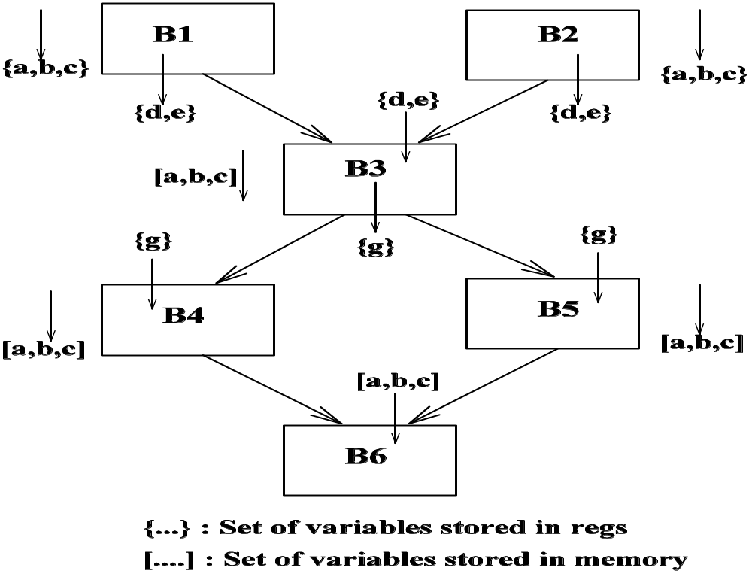
Global Register Optimization

Slide 57
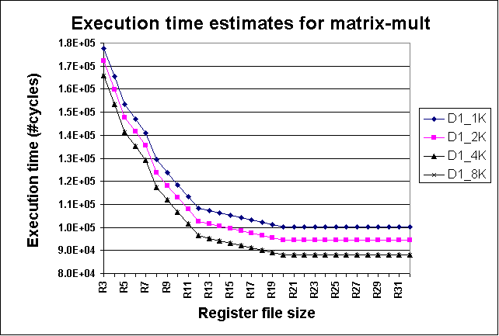
Exploring Reg. File and Cache Size
Execution time <= 1.0E+05
12 registers with 4K cache
15 registers with 2K cache
20 registers with 1k cache

Slide 58
Features of Register File Size Exploration
Register allocation is performed before scheduling
Consider global needs
Extended to explore register windows and cache configurations
No target specific code generation or simulation
Simple processor description, retargetable
Performance is estimated using a scheduler and profile values
Validated for ARM7TDMI and TM-1000 and LEON processors
Nearly 77 times faster compared to compiler simulator framework

Slide 59
Sample machine description
MACHINE ISSUE SLOTS 1
REGISTERS 16
NUMBER OF PIPELINE STAGES 4
PIPELINE STAGES IF ID EX WB
NUMBER OF WRITE BUSES 1
FU alu
NUMBER 1
OPERATIONS io_ldc 1 io_cpy 1 io_add 1 io_sub 1 io_neg 1 io_not 1 io_and 1 io_ior 1 io_xor 1 io_abs 1 io_cvt 2 io_seq 1 io_sne 1 io_sl 1 io_sle 1 io_min 2 io_max 2 io_abs 2 io_mul 3 io_lod 2 io_str 1 io_memcpy 3 io_asr 2 io_lsl 2 io_lsr 2 io_rot 2 io_btrue 4 io_bfalse 4 io_jmp 3 io_cal 24 io_ret 3 io_lab 1 io_mbr 4 io_seq 2 io_sne 2 io_sl 2 io_sle 2 io_div 3 io_rem 3 io_mod 3 io_divfloor 1 io_divceil 1
SLOTS 1 : 1

